Slide 1

Exception Handling
Notes:
In this lesson, we will discuss exception handling, which is how we can gracefully handle when something unexpected happens during the running of a program instead of just having the program crash.

Slide 2
Objectives
At the end of this lecture, you will learn
What are exceptions
How to handle exceptions
Using assert to help test your code
Notes:
We will talk about how Python implements exceptions when something unexpected happens, and how we can make use of exceptions to stop the program from crashing. Finally, we touch on the use of the assert feature, which allows you to deliberately raise an exception depending on whether a particular condition is true.

Slide 3
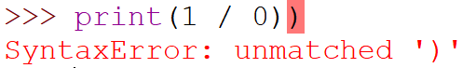
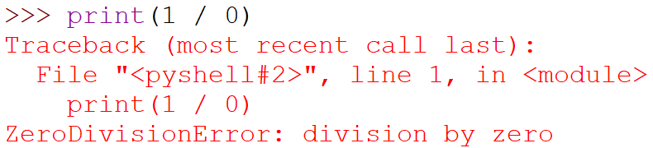
Syntax Errors vs. Exceptions
A syntax error occurs when the program structure is wrong:
Happens before the code is executed
An exception happens in syntactically correct code
Happens during runtime (the program “crashes”)
Notes:
Broadly speaking, there are two types of errors that can cause a Python program to crash. Syntax errors occur when the program structure is wrong, such as when there is an unmatched bracket, an else that is not matched to an if, or an unexpected indentation. These errors are detected by the parser before the code is even executed, and can be corrected by using the correct syntax.
The other type is called an exception. This happens when the code is syntactically correct, but something goes wrong during execution. For example, when the program tries to divide a value by zero, an exception called a ZeroDivisionError is raised.

Slide 4
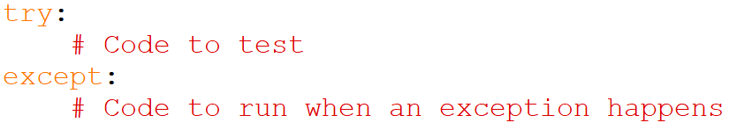
Exception Handling
We want to avoid our programs crashing
If we know an exception could be raised, we can anticipate it using try…except…
Notes:
In general, it is a good idea to avoid having our programs crash. If we can anticipate when something unexpected happens, we can try to cater for it and at least provide a useful error message to the user. In Python, we do this using the try…except… block. The code under the try block is the code that you want to test that might raise an exception. The code under the except block will be executed if an exception is raised.

Slide 5
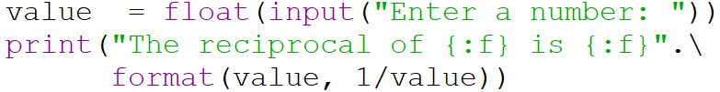
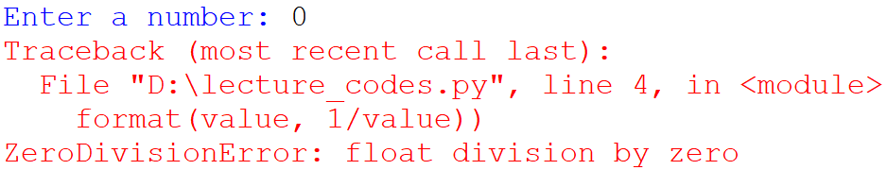
try…except…
Example without exception handling:
Sample run:
Notes:
For example, consider the following code that computes the reciprocal of a number that is entered by the user. If the user enters zero, the division operation will raise a ZeroDivisionError exception and the program will crash.

Slide 6
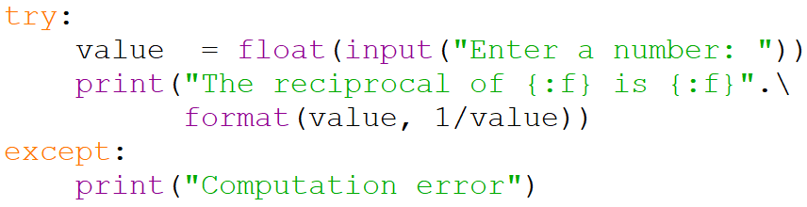
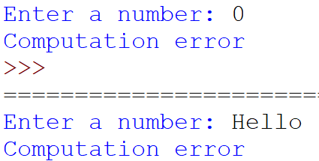
try…except…
Example using try…except…:
Sample runs:
Notes:
To avoid this crash, we can encapsulate the code in a try…except… block. This way, when the code raises the ZeroDivisionError exception, the code in the except block will be executed. Here we print the error message “Computation error”. Note that the except block executes no matter what exception is raised, so if the user enters a string like “Hello” and the program attempts to convert it into a float, the ValueError that is raised will also cause the except block to execute.

Slide 7
Common Built-in Exceptions
Exception | Description | Example
Exception | All built-in exceptions.
AssertionError | When an assert statement fails (discussed later in this lesson). | assert 1 == 2
ModuleNotFoundError | Raised when the import statement has trouble loading a module. | import maht
Notes:
Python provides several in-built exceptions. Here are a few of them.
All exceptions derive from the Exception base class. You will learn more about base classes when you cover object-oriented programming in future modules.
An AssertionError is raised when an assert statement fails. We will discuss more about assert statements later in this lesson.
A ModuleNotFoundError is raised when the program attempts to import some module, but encounters some problem. In this example, the name of the math module was misspelled, leading to a ModuleNotFoundError exception.

Slide 8
Common Built-in Exceptions
Exception | Description | Example
IndexError | Raised when a sequence subscript is out of range. | list = [4, 2] print(list[2])
NameError | Raised when local or global name is not found. | value = 4 print(Value)
TypeError | Raised when an operation or function is applied to an object of inappropriate type. | n = math.sqrt('4')
Notes:
An IndexError is raised when a program attempts to access an element in a sequence that is out of range. For example, if you try to print the element at index 2 in a list that only has two elements, an IndexError will be raised because the list only has elements at indexes 0 and 1.
A NameError is raised if you try to access a variable or function before it is declared.
A TypeError is raised when a function is given an argument of the wrong type. In this case, the math square root function is expecting a numerical value, but is given a string instead. This raises a TypeError.

Slide 9
Common Built-in Exceptions
Exception | Description | Example
ValueError | Raised when an operation or function receives an argument of the right type but inappropriate value. | n = math.sqrt(-1)
ZeroDivisionError | Raised when the second argument of a division or modulo operation is zero. | n = 5 % 0
FileNotFoundError | Raised when a file or directory is requested but does not exist. | f = open('prog.yp')
https://docs.python.org/3/library/exceptions.html
Notes:
On the other hand, a ValueError is raised if the type of the argument is correct, but the value is not. If you call the math square root function on a negative number, it is not a TypeError since square root is expecting a numerical value. However, it raises a ValueError because square root can only handle a non-negative value.
You get a ZeroDivisionError if you try to divide or modulo by zero.
A FileNotFoundError is raised when you attempt to access a file, but the system cannot locate the file.
There are several other in-built exceptions provided by Python. The full list can be found via this link to the official Python documentation.

Slide 10
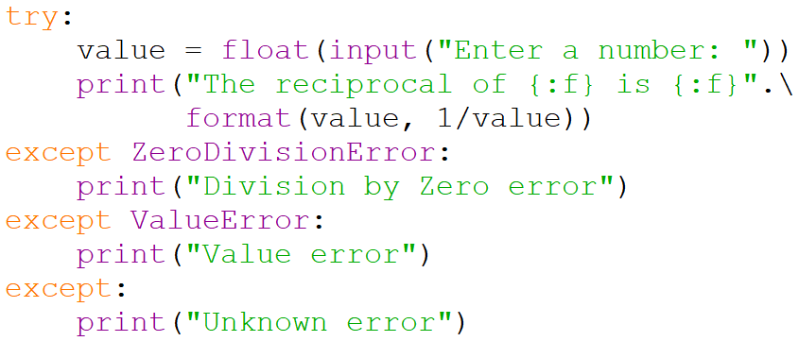
Handling Specific Exceptions
We can handle specific exceptions differently
Notes:
What if you want to handle specific types of exceptions differently? Consider this code, where we want to differentiate between a ZeroDivisionError and a ValueError. We accomplish this by having multiple except blocks according to the type of exception we want to handle. We can also have an empty except block that will handle all other exceptions that we do not specifically handle.

Slide 11
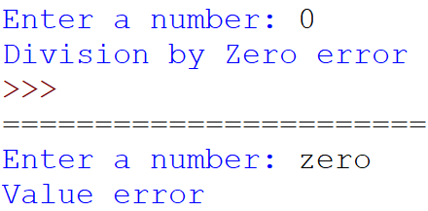
Handling Specific Exceptions
Sample output
Notes:
By doing this, we can provide customized reactions depending on the type of exception raised.

Slide 12
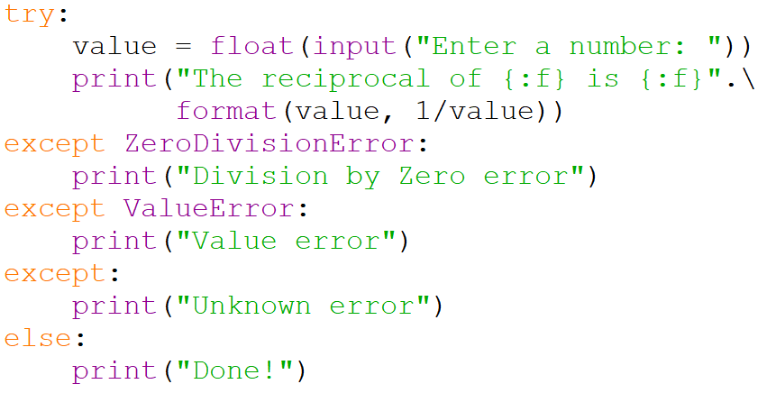
The else clause
We can use else to execute a block of statements only if there are no exceptions
Notes:
Python also allows us to have a block of statements that is executed only if there are no exceptions (which means that if an exception is raised, this code is skipped). This is done using the else clause. In this code, we print “Done!” only if there are no exceptions raised.

Slide 13
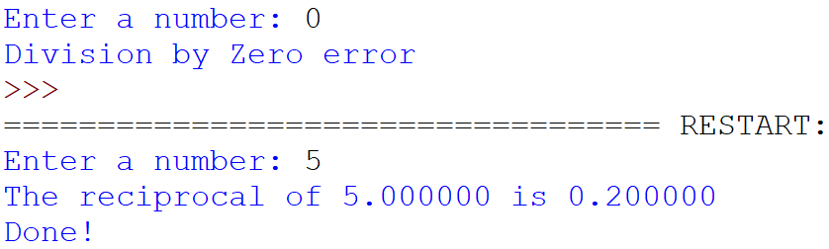
The else clause
Sample output:
Notes:
When we run this program, we see that “Done!” is not printed when the ZeroDivisionError is raised. However, when the code executes successfully without raising any exceptions, “Done!” is printed.

Slide 14
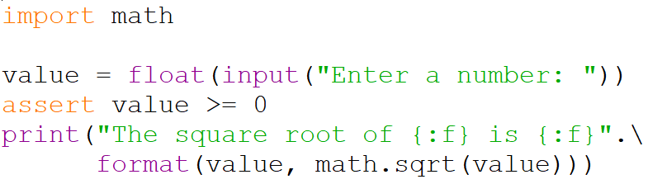
Testing using assert
We can use assert to test if a condition is true
If the condition is true, the code continues to execute
If the condition is false, an AssertionError is raised
Example:
Notes:
Python provides a feature called assert. To make use of this feature, we use the keyword “assert” followed by an expression that evaluates to true or false. In general, we will write an expression that we expect to be true at that point in the code. If it is indeed true, the code continues to execute. But if it is false, the program will raise an AssertionError.
In this example, we ask the user to enter a value. We use an assert statement to assert that the value entered must be at least zero. We then compute and print out the square root of the value.

Slide 15
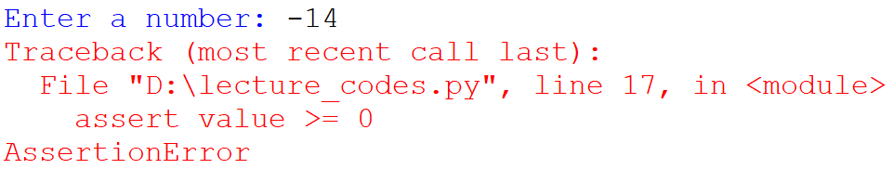
Testing using assert
Sample output:
Notes:
When the program is run, suppose the user enters a negative value. The assert statement will detect that the expression “value >= 0” is false and raise an AssertionError. Notice that the error message shows the statement that raised the AssertionError, which is useful to help you debug your code.

Slide 16
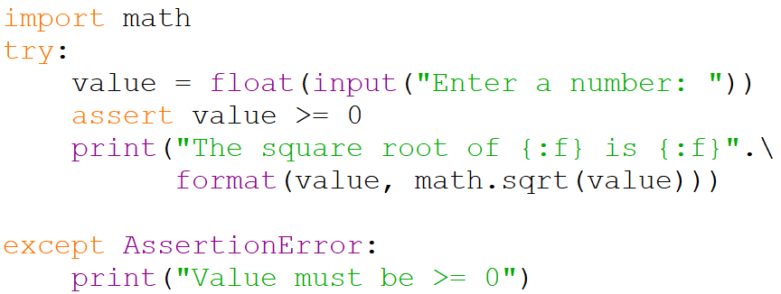
Testing using assert
assert is a convenient way to check if a condition that you expect to be true is actually true
Since an exception is raised, you can treat it like other exceptions
Notes:
assert is a useful feature for debugging, especially when you are writing more complex code. Like all exceptions, you can handle AssertionErrors using an except block, as is given in this example.

Slide 17
Activity Break!
Lecture activities are in a separate file (Word document)
You are required to submit your solution for the activities in POLITEMall when you have completed all of them
Try to work on activities 4 and 5 now…
Notes:
Music from https://www.fiftysounds.com/royalty-free-music/marseille.html

Slide 18
Summary
When something goes wrong in a Python program during run-time, an exception is raised
Python implements several built-in exceptions
Understanding the types of exceptions raised can help you debug your code
We can use assert to help us make sure that a particular condition is true
Not covered: user-defined exceptions
Notes:
In summary, Python raises an exception when something goes wrong during run-time. There are several built-in exceptions supplied by Python, and it is important to understand what these exceptions mean and when they are raised in order to help you narrow down the possible sources of your program’s error. In addition, we can use the assert statement to help us make sure that a particular condition is true at some part of the code, and handle that exception accordingly if it turns out to be false.
You may be interested to know that it is possible to define your own special types of exceptions. We leave this for you to research on your own.

